Slide 1
Col. John Boyd
More than the OODA Loop
Steven Davis
stevendavis1956@me.com

Slide 2
Col John Boyd
Col John Boyd –
More than the OODA Loop
Primarily based on the book
Boyd: The Fighter Pilot Who Changed the Art of War
by Robert Coram

Slide 3
Col John Boyd
Introduction
Birth and Early Life
Korea
Nellis AFB
Georgia Tech
Eglin AFB
The Pentagon
Later Life

Slide 4
Introduction
Col Boyd is primarily remembered for his OODA Loop
  Observe
  Orient
  Decide
  Act

Slide 5
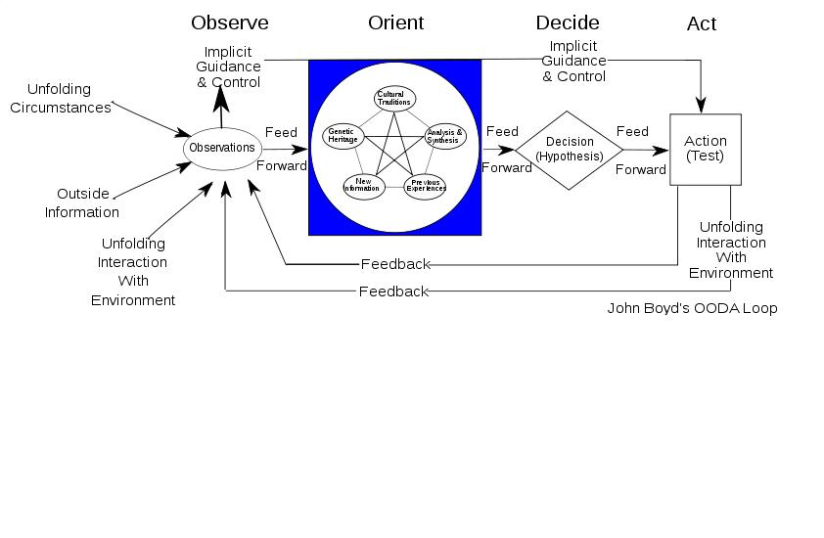
Introduction

Slide 6
Introduction
The OODA Loop is the basis for the AF 8-Step Problem Solving Process
  Observe:
    Step 1 – Clarify & Validate the Problem
    Step 2 – Break Down the Problem / Identify Performance Gaps
  Orient:
    Step 3 – Set Improvement Targets
    Step 4 – Determine Root Causes
  Decide:
    Step 5 – Develop Countermeasures
  Act:
    Step 6 – See Countermeasures Through
    Step 7 – Confirm Results & Process
    Step 8 – Standardize Successful Processes

Slide 7
Introduction
But Col Boyd was much more than the developer of the OODA Loop …

Slide 8
Birth and Early Life
John Richard Boyd was born 23 Jan 1927 in Erie, Pennsylvania
Army Air Corps
  During World War II, he enlisted on 30 Oct 1944, when he was a junior in high school
  He was discharged on 7 Jan 1947
Boyd attended the University of Iowa, graduating with a Bachelor’s of Economics
During the Korean War, he enlisted in the Air Force on 8 Jul 1951
He married Mary Ethelyn Bruce
  They eventually had five children

Slide 9
Korea
Boyd arrived in South Korea as a fighter pilot on 27 Mar 1953
Hostilities ended before he had a chance to shoot at a MiG
He became intrigued with the relative performance of the MiG-15 vs F-86
  On paper, the MiG-15 was superior is almost every respect
  But the F-86 had a 792 to 78 (over 10-1) kill advantage over the MiG-15
  Why?
    Superior pilots and training could be a factor
    Visibility – the F-86 has a bubble canopy with 360-degree visibility, while the MiG-15 pilot’s visibility is blocked to the rear; therefore, the F-86 pilot has better situational awareness
    The F-86 has full hydraulic controls which the pilot can operate with one finger, while the MiG-15 has manual controls, resulting in the MiG-15 pilot becoming fatigued more quickly and taking more time to go from one maneuver to another than the F-86 pilot

Slide 10
Nellis AFB
Boyd arrived in Apr 1954 as a student in the Advanced Flying School (AFS)
Upon graduation, he became an instructor in Fighter Weapons School (FWS)
  There was no air-to-air tactics manual, so Boyd decided to write one
    This became his Aerial Attack Study
    In 1960, it became the official tactics manual for fighter aircraft
      Fighter tactics were no longer a “bag of tricks”
      It provided instructions for dealing with any situation a pilot was likely to encounter
Boyd decided he needed to better understand the math and physics behind fighter performance, so he chose to pursue an engineering degree

Slide 11
Nellis AFB
“Forty-Second Boyd”
One of Boyd’s teaching tools was to have the student place his fighter on the six o’clock position of the instructor’s aircraft and stay there as the instructor goes through evasive maneuvers
This developed into a standing offer:
    With an adversary on his six, Boyd would either be in position to shoot down other fighter within 40 seconds or he would pay the pilot $40
    Boyd never lost, to students or to experienced AF, Navy, Marine Corps, or foreign exchange pilots

Slide 12
Georgia Tech
Started class in Sep 1960
Majored in Industrial Engineering
Developed his Energy-Maneuverability (E-M) Theory
Graduated after Summer Quarter 1962

Slide 13
Georgia Tech
Energy-Maneuverability (E-M) Theory
$$P_{S}=\left[\frac{T−D}{W}\right]V$$
  T = Thrust
  D = Drag
  W = Weight
  V = Velocity
Provided a quantitative basis for developing aerial tactics
Changed how aircraft are flown in combat
Provided a scientific means for evaluating maneuverability of aircraft
  Tactics to overcome limitations of own aircraft
  Tactics to minimize or negate superiority of opponent aircraft
Tool for designing fighter aircraft

Slide 14
Eglin AFB
After graduating from Georgia Tech, Boyd was stationed at Eglin AFB, Florida
He concentrated on his E-M charts, where he compared US fighter aircraft with Soviet fighter aircraft in all parts of the flight envelope – any altitude and any speed

Slide 15
Eglin AFB
The F-111
The F-111 was in development at the time
It was Secretary of Defense Robert McNamara’s universal fighter for the AF and Navy, supposed to reduce:
  Development costs (only one aircraft to be developed)
  Production costs (increased quantities of one design)
Swing wing design
  Lower takeoff and landing speeds for carrier operations
  Better high speed performance
  However, this significantly increased weight
Boyd’s E-M charts showed that Soviet aircraft could defeat the F-111 at any altitude, any airspeed, in any part of the flight envelope

Slide 16
Eglin AFB
Boyd was awarded the Air Force Systems Command (AFSC) Scientific Achievement Award, the highest scientific award in AFSC
He was also awarded the Air Force Research and Development Award for Aeronautical Engineering, the highest scientific award the AF gives to an officer

Slide 17
The Pentagon
F-X
In 1966, Boyd was transferred to the Pentagon to work on the troubled F-X, the new AF fighter
  The original F-X was a large, heavy, swing wing design that repeated the mistakes of the F-111
  Although only a major at the time, Boyd used his E-M Theory to justify eliminating the swing wings and drastically reducing weight
  The resulting F-15 was the first AF fighter designed for dogfighting
  However, Boyd was not pleased, as he thought the F-15 was still too heavy and too compromised

Slide 18
The Pentagon
Lightweight Fighter
Unhappy that he thought the F-15 was too heavy and too compromised, Boyd began work on the Lightweight Fighter
  It was to be light, simple, and inexpensive
  Two contractors, General Dynamics and Northrup, were selected to build prototypes for a fly-off competition
  General Dynamics won the competition to build what became the F-16
  However, Boyd was not pleased, as he thought the F-16 was still too heavy and too compromised

Slide 19
The Pentagon
On 25 Jun 1975, Boyd received the Harold Brown Award, the highest scientific award presented by the AF
  Citation noted how E-M Theory was used for designing the F-15 and F-16
  It stated that E-M Theory gave the AF the means to “forge a superior fighter force in the decades ahead”
Boyd retired from the AF on 31 Aug 1975
He continued to work as a DoD consultant

Slide 20
Later Life
Boyd moved to Delray Beach, Florida, in 1988; he continued to work as a DoD consultant
In Jan 1980, he began working with the Marine Corps, developing “Maneuver Warfare”
He served as an advisor to Secretary of Defense Dick Cheney during Operations Desert Shield and Desert Storm
  Three days before the war officially began, the Marine Corps executed a raid deep behind Iraqi lines, perfectly executing “Maneuver Warfare,” resulting in 15 Iraqi divisions surrendering to two Marine Corps divisions
  Anecdotal evidence suggests the famous “Left Hook” was Boyd’s idea
Boyd died of cancer on 9 Mar 1997 in West Palm Beach, Florida
His ashes are buried in Arlington National Cemetery

